Slide 1
Big Data In Game Analytics - Know our players better
- Su YANG

Slide 2
Why should we adopt Big Data?
Today, 2.5 quintillion bytes of data is created every day, meaining 90% of the existing data in the world has been created in the last two years alone.
According to Mckinsey: Better Marketing analytics improve the returns on marketing by 10-20%, source.
In every sector: companies using Big Data generate 6% more profits and is 5% more competitive to their counterparts in the same business bracket.
Between 2010 and 20 12, the percentage of insurance companies that adopted/reported a competitive advantage by use of Big Data has surged from 35% to 74%, Source.
Ex: Twiddy & Company, a rental firm, cuts costs by 15 by comparing each contractor’s maintenance charges against the average of its 1200 other vendors etc…
Ex: Smartzip uses metadata on inhabitants of an area and predicts what house owners are the most likely to sell. And they are right at 80% of the time for a predictive period up to 3 months! This is what we call the “Target Data”.

Slide 3
What the competition does (as of May 2015)
Riot (mono-brand): Insights (Bradon Hsiung Analytics, data science, research and data engineering. Since 2012), e-commerce (Mark Sottosanti, pricing policies and philosophies) and social (2.2 million Twitter followers and 12.5 million likes on Facebook.). For instance, Riot is looking to transition from a manual sanction model Tribune to a Machine-learning system to automatically punish/reward players (it is still in research at the moment) but I have better idea.
Blizzard (multi-brand): MapR (a distributed Hadoop service social used by Blizzard, they have small teams for specific games/purposes, the longest-standing one is led by Chaitanya Chemudugunta dating back to 2009), social(nearly 700K Twitter followers and 6 millions likes on Facebook for WoW alone)
Valve (closed-economy): Their data-approach is more pricing-oriented, which makes them more profitable on a per employee basis than let’s say likes of Google or Apple. Their head-economist is Yannis Varoufakis (a renowned grec economist, game theorist) since 2012.
Zynga (cross-brand optimization): Zynga Analytics (Daniel McCaffrey) It is the perfect example of data-driven gameplay optimizations company, their goal: maximize user conversions and revenues. In other words data is the core-business of Zynga(this is not the preferred way since I believe it can burn out users very quickly, since players are no longer considered the core-business here)

Slide 4
But we can do better (At least we can start to do similar things)
Rainbow Six 6 (Competitive&social): ML is crucial in competitive space because: data is big, non-static and memory-dependent; Competitive games are complex so bias can be exploited, Tools to pinpoint the bias before the players can are needed; managing the community is essential, big community means no manual& real-time ways to reduce toxicity and reward good behavior can be found, in other words we need a timely customer service; The security can be improved via anomaly detection algorithms to detect bots and account thieves; The seasonality, on a general sense of the term, or a roadmap of promotional/ competitive events and exclusive events plus the frequency/nature and audience are subjects to ML algorithms.
Ex: Summary of good and bad behaviors of the player at the end of each month and say: “hey, you’re doing this but by doing that you’ll likely to win 2% more” or “hey, you’re getting reported for that number of time for those reasons, if you change you’ll get such a reward, otherwise you may get banned” etc… (this is social engineering atop ML results).
Betas: More and more games (especially AAA) require high quality betas and longer beta phases, meaning we possess players’ in-game behaviors before the game is released, with/without monetization pattern. We can utilize existing data to both predict conversion rate to full game and conversion rate to monetize and even how much.
Ex: Instead of the same perks for everyone who pre-orders, we can imagine way bigger perks from which player can choose from. Plus it can give us insights on what type of players they are.

Slide 5
But we can do better (At least we can start to do similar things)
Profiling and Targeted experience (AAA Brands – AC/FC/WD) :
If players are different: random events can be less random and more tailored; the in-game messaging can also be player-focused. It is important to reduce the marketing appearances and retain the marketing efficiency.
Ex: “Hey there is a new DLC that gives you a new map to explore” and “Hey there is a new DLC that gives a new king to kill” will not be targeted at the same player.
Independently of how players are different (explorer, hardcore, casual, achiever etc…). It is safe to say players from different countries/region/culture/age will react differently to contents: Do we need a more culture-related sub-analysis before new contents implementation? It is also interesting to see if and why players change categories: what has changed? Maybe new characteristics arise (different categorization) or more granular analysis are needed (sub-categories?).
Ex: If I know Koreans/Chinese people are more likely to grind, Europeans like to explore and Americans like to experience Catharsis (doing things that are forbidden in real life), I would consider different kind of promotional events for everyone such as “kill XX monsters in YY time”, “Explore XX% of the map over the week-end will give you YY” or “For a limited time, you can kill neutral NPCs giving you achievements you’ll never get otherwise”

Slide 6
But we can do better (At least we can start to do similar things)
Creating a “Ubiverse”?: It could be a good idea to build our brand as a whole instead of separated AAA brands, it enables fidelity cross-brands, helps to build a more centralized and manageable reputation and a more stable community. It allows us to better predict and orient customers behavior, making conversion/retention easier. But a more timely adaptation to social media inputs/outputs become crucial.
Ex: Create place with the Ubifans, who can be a Ubi-assassin, Ubi-FarCryers and show off the achievements, videos, tricks and fun facts etc… the adhesion needs the user to have the game. It is a great way for the community to self-promote and generate more data.
Information management: Managing information is crucial if social media is involved: what channel to use for the next AC announcements? The gameplay reaveal? Should we also use in-game messaging/Twitter? Do we do it on Youtube/Twich? Should the latter have a live stream Q&A? Should we hold a Reddit AMA simultaneously or shortly after? How do we quantify that? Is there a centralized/optimized way to reach our audience and convert them to attend? How do we balance the information on Edge/Gamasutra/Joystiq/IGN etc…?
Ex: Very simply, if one person has 1 million followers on Twitter, we should make sure that person is aware and retweets, the same for famous Youtubers and Twichers. By considering people as nodes of a graph, we can use classical percolation/random work/stepping stones theories to predict the optimized ratio resources/information coverage.

Slide 7
General Trends in the industry
Game monetization optimization (more for social games).
Gamification (gamification involves the introduction of game elements such as leaderboards, badges, trophies, points, virtual currency and credits, and more to reward desired behaviors. ). Even other sector such as UnitedHealth Group in HealthCare use the principle to promote self-management of wellness and healthy behaviors (but also employee recognition programs). Today $2 billions are spent in these regards, but no game analytics are here to measure the impacts of the Gamification. (Another example is Target, by using beeps and green light, it increases cashier efficiency, lowers checkout times and increase employer’s morale.
Profiling: find players with the highest propensity to monetize, return to monetize, encourage other people to monetize or become a social “leader”; finding the interests of players to do better target marketing.
Social Engineering: find the right information entrance channel, punish reward certain behaviors to promote the desired ones, make different experiences to cater all sorts of players and set up “objectives” (unique events, seasonal events, regional events, random events, conditioned events, live events etc…)

Slide 8
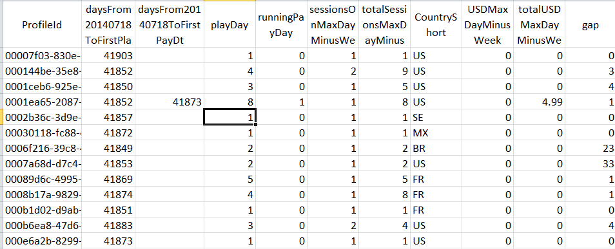
Case study: AirMech (Predicting who will leave)
Scope of the data: X360, a sample of 100,000 players, 75283 used as training sets and 24717 (of which 12518 are considered leavers) as test sets. 21 parameters are used. The snapshot is taken a from before the “last play date”, people who will play once during the following 2 months are considered “returned players” otherwise they are “leavers”.

Slide 9
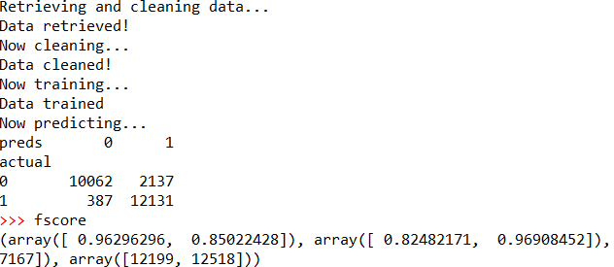
Case study: AirMech (Predicting who will leave)
Results: 85.0% precision, 96.9% recall and fscore=0.89 -> Of the players I predicted as leavers, 85.0% are really leaving; 96.9% of leavers have been found! (This is abnormally high) Fscore can be interpreted as a balanced view of the two formerly mentioned metrics.
Number of players
Persistent Level

Slide 10
Case study: AirMech (Predicting who will leave)
Limits of the data: data set very small for big data; the definition of leavers should be reassessed (maybe looking at the cumulative play days/hours/hours played during play days for the last 30 days); It is slightly biased for players of level 1 without which the non-leavers will be skewed; Certain metrics (first play date minus a fixed date -> dubious)
Limits with the method: the data hasn’t been processed so every parameters have same weight which shouldn’t happen if we have better insights over the data set. In other words, specialists of a given game will pinpoint the obvious bias of the dataset so as to pre-categorize players before running the algorithm, for instance it seems natural to pre-group players per level bracket (or at least eliminate edge cases).
How to utilize the results: Once the leavers are predicted, we should use clustering methods to separate them into targetable groups and use tools to retain the players, for instance for some players, it may be the only time they played for the last month, those are players who are “giving chance” to the game again; some may reduce the time played because the contents are repetitive; some may have received major losses on that very day and stop playing; some may just have encountered bugs etc…

Slide 11
Case study: AirMech (Predicting who will leave)
So: I have predicted that 14268 players out of 24717 are leavers (and correctly for 12131 of them) whereas 12518 truly are of which I have missed 387 players. It doesn’t matter the players I missed since without the analysis I wouldn't notice it.
The hypotheses we need to make: Marketing costs per player (MCPP); The success rate (X% chance for them to play Y more time); The ARPU over the Y time period; The marketing doesn’t affect the players who are not predicted to leave and N is the number of leavers (here N = 12518). And we basically want this:
ARPU(Y)*Recall*N*X%-MCPP*Recall/Precision*N
to be positive at least but as big as possible. Since ARPU is a static variable if a snapshot is taken (still a variable in the estimation), the only variable thing once we are at execution is the marketing strategy which will affect MCPP, X and Y.
We can already see that if the category is skewed (N small), the result will not generate enough profits as well as a small Recall (same principle: not enough leavers or if we can’t find enough of them, it is not very profitable). And it comes all down to the maximize precision (optimize algorithm/data) and find the optimum of the formula ARPU(Y)*X%-MCPP*1/PrecisionMax (Optimize the marketing strategy). We can layer this with a clustering algorithm afterwards which will yield a similar profitability formula, and we may have a better ARPU(Y)*X%-MCPP*1/PrecisionMaxPerCategory if we target the right audience with the right strategy.

Slide 12

Case study: AirMech (Smart Data vs Big Data)
But, without context, running a black-box like algorithm doesn’t help you get the right result even the apparent result is good. For instance we can perform the same algorithm by taking only players with level > 2. And we will look at the differential between the start date and the day the data is pulled instead of a fixed original date. This makes the result more realistic. In a business-like situation one has to sit down with an expert of the game and take into account the influence of levels, time spent in total etc.. Because those parameters have obvious influence on the outcome.!
In this case, we got 74.1% precision and 89.3% recall, which has room for improvements, but all in all stay perfectly fine for our purposes. Let’s do a very rough numerical estimate: we have an average ARPU per day of $0.0167 for the whole dataset, $0.2 of MCPP with a two months retention and 50% success rate, N=11665.
60*0.0167*11665*0.893*0.5-0.2*0.893/0.741*11665 = $2407
Moreover I found out several key metrics here: maximum session amount of kudos and diamonds earned by someon; the number of times the player leaves a game before it ends, all those important parameters emerge after hundreds of iterations of the algorithms.

Slide 13
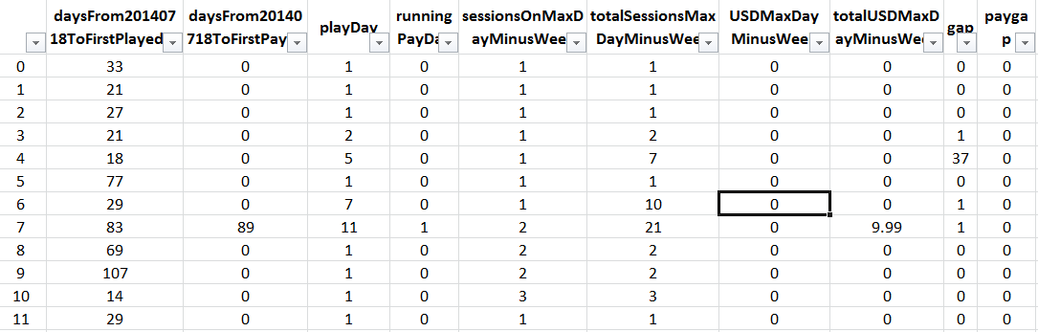
Case study: AirMech (Players classification)
Scope of the data: X360, a sample of players (100K profiles). 20 parameters are used.

Slide 14
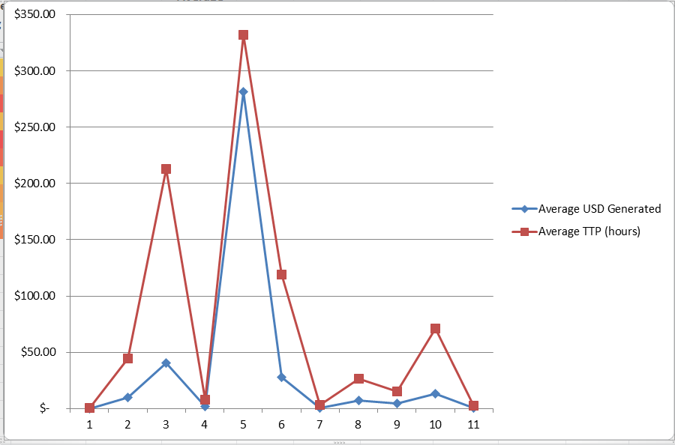
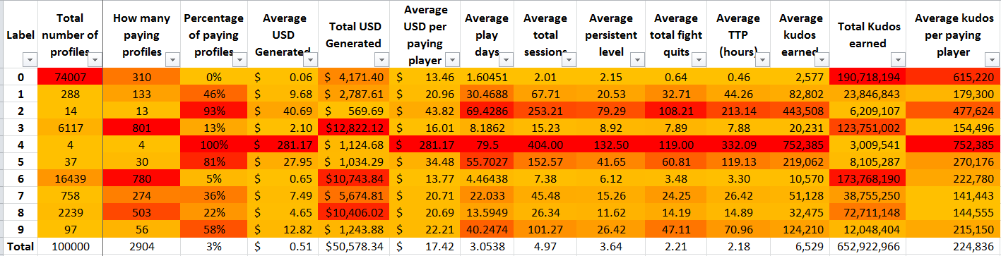
Case study: AirMech (Players classification)
Results: 10 categories. We can observe
some correlations, but also to see if certain
categories are monetizing “better” with
regards to other metrics, here I would
say 5s are monetizing well so we should
Reward, the 3s spend a lot of times playing,
thus needs more marketing attention.

Slide 15
Case study: AirMech (Players classification)
Limits of the data: It is still small, ideally we want to process over 1 million data points at least (it is called big data for a reason). Some parameters are too connected here to be considered independent, I’m merely analyzing over a small pool of factors; The data is in reality skewed (a lot of level 1s) and we normally wouldn’t consider people with less than 30min gameplay.
Limits with the method: This is an experimental study that doesn’t stress very specifically on the objective, do we need a monetizing profiling? Do we need player game-play profiling? Or do we evaluate the “strength” of a player?
How to utilize the results: it is a great promotional tools to display the different categories of players… It can be used to make tailored contents/marketing. For instance, I will not perform in-game messaging for an exploration-oriented DLC if the player is an “monster killer”, and if random missions can be unlocked entering a map, the player’s category will trigger the right type of mission.

Slide 16
Conclusion
Via Machine Learning techniques, we can improve our business in ways we couldn’t before:
Improve conversion and retention rates by spotting as soon as possible potential buyers, leavers.
Improve in-game experience and targeted marketing by recognizing what type of player we’re dealing with.
Improve the community management by using tailored carrots/sticks to address toxic behaviors.
Improve match-making with a more memory-dependent, data-focused approach.
Etc…
But most importantly: 99% of the time a machine learner will try to understand data better, and nothing but this perspective make the whole process extremely useful (new way of combining data, understand what metrics are the most powerful to explain trends)
Other ideas for analytics I can further develop atop ML techniques:
Information propagation (percolation, random walks and Internet Web graph): How to optimize information diffusion in the community.
Social engineering (analytical psychology, neuroscience and behavioral studies atop ML results): How to improve players’ feedback? Improve players in-game behavior especially for the upcoming RS6 game in which community is extremely important.

Slide 17
What simple questions can be addressed
Binary questions:
Is a player a one-time transaction type of player or multiple-times transaction type of player?
Can we predict if a player is leaving the game within next 2 weeks? (What policies to adopt to keep those players)
Classification questions:
Can we have 10 categories of monetizing players? How to label them?
Can we put players into 15 different spaces of distinct skillcap.
What type of players is there in-game (explorer, achiever, raider, social leader, pvpers etc…)?
Regression questions:
For a player having played for X time and monetized Y time, can we predict how much money will he/she spend within next month?
Can we predict the amount of time a player is going to spend per day?
How toxic is a player?

Slide 18
How does it work? (Regression)
Regression type of algorithm: It sets up a relationship manager that allows us to predict a certain metric predefined with certain inputs.
?
I am FPS
I am Rainbow six!
My name is colorful
Algorithm
I was born in 1998
?
I’m Mario Bros: syndicate
(Or am I?)
I have the most brothers
Europe
Victory is not my name
Relationship manager

Slide 19
How does it work? (classification)
Classification type of algorithm: builds a classifier that will be able to categorize new sets of inputs into predefined labels.
Rainbow six
First Person Shooter
?
Assassin’s Creed Unity
Action/ Adventure
?
Child of Light
Role Play Game
Algorithm
?
Adventure / RPG
Classifier
Watch Dogs 2
Chesslike Strategy
Might and Magic X
MMORPG (or am I?)
Next mysterious game

